Slide 1
Aria Operations
EXPERIENCE DAYS
Bengt Grønås and Kate Rychlic
Cloud Management Specialists
onsdag 29. mars 2023
Notes:
Click to add notes

Slide 2

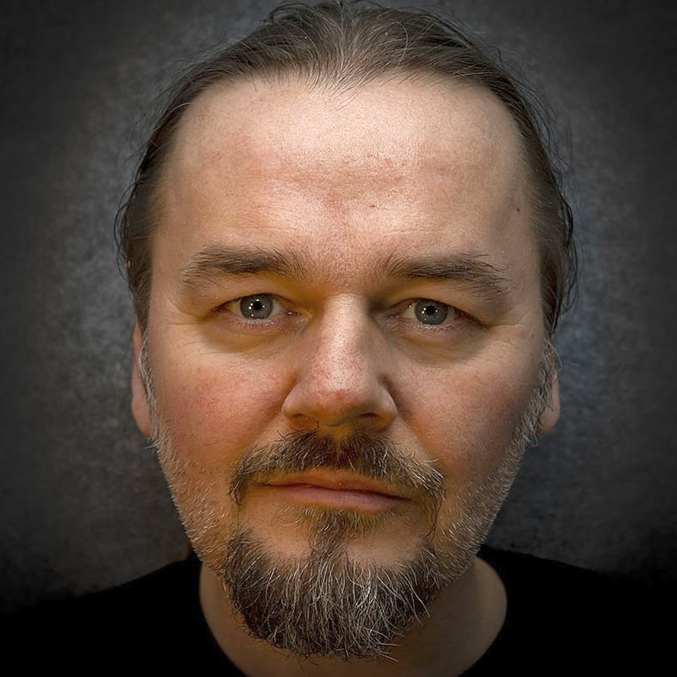


Introduction
BENGT GRØNÅS Senior Solutions Engineer 8 years in VMware Based in Oslo, Norway Covers Nordics and Baltics Often a Lab Captain at Vmware Explore / VMworld Music production, long travels; hiking, motorcycle, chess @bgronas
Kate Rychlic Senior MultiCloud Management Specialist Solution Architect Aka. Kasia, Katia, etc 199 years in VMware Based in Amsterdam, Netherland Covers the world Carcrashing, DIY, hobbies, interests, bla bla.. @krychlik
Notes:
Here we are
NEXT: Let’s have a slow start and a look at WHY we should have VROPS/AO

Slide 3

VMware Cloud Management: vRealize, Skyline, CloudHealth
VMware Cloud Management
VMware Cloud Universal
vRealize Network Insight Cloud
vRealize Automation Cloud
vRealize Operations Cloud
vRealize Log Insight Cloud
Skyline Proactive Intelligence
vRealize AI Cloud
CloudHealth by VMware
SaaS
Wavefront
vRealize Network Insight
vRealize Automation
vRealize Operations
vRealize Log Insight
On-prem
On-premises / SaaS Choice
SaaS Only
Notes:
Both OnPrem AND Cloud == Same Same

Slide 4
Cloud Management New Family Brand: VMware Aria
Old Name | New Name
Automation
vRealize Automation / Cloud | VMware Aria Automation
VMware Cloud Assembly | VMware Aria Automation Assembler
VMware Service Broker | VMware Aria Automation Consumption
VMware Code Stream | VMware Aria Automation Pipelines
VMware Cloud Templates | VMware Aria Automation Templates
vRealize Orchestrator | VMware Aria Automation Orchestrator
vRealize Automation SaltStack Config | VMware Aria Automation Config
vRealize Automation SaltStack SecOps | VMware Aria Automation for Secure Hosts
CloudHealth Secure State | VMware Aria Automation for Secure Clouds
Operations
vRealize Operations / Cloud | VMware Aria Operations
vRealize Log Insight / Cloud | VMware Aria Operations for Logs
vRealize Network Insight / Cloud | VMware Aria Operations for Networks
Tanzu Observability by Wavefront | VMware Aria Operations for Applications
vRealize True Visibility Suite | VMware Aria Operations for Integrations
Cost
CloudHealth | VMware Aria Cost powered by CloudHealth
Old Name | New Name
Suites
vRealize Cloud Universal | VMware Aria Universal Suite
vRealize Suite | VMware Aria Suite
vCloud Suite | VMware vCloud Suite
CloudHealth by VMware Suite | Discontinued Name
CloudHealth Partner Platform | Discontinued - see Aria Cost powered by CH
Platform & Cross-Cloud Services
Project Ensemble | VMware Aria Hub
New | VMware Aria Graph
vRealize Migration Manager | VMware Aria Migration
vRealize Automation Cloud Guardrails | VMware Aria Guardrails
Project Ensemble Insights | VMware Aria Business Insights
Other
Skyline | VMware Skyline
vRealize Suite Lifecycle Manager | VMware Aria Suite Lifecycle
vRealize Cloud Subscription Manager | VMware Aria Hub Subscription
vRealize AI Cloud | Functionality part of Aria Hub; name discontinued
Notes:
Before we go on, let’s kill the elephant in the room
WHAT ABOUT THAT NAME CHANGE RECENTLY?
Always use full product names in any externally-facing content.
At the first mention add can drop it in subsequent mentions
Never abbreviate the names. Exception: in product UI (menus and drop-downs) if the full name doesn’t fit you may drop “VMware Aria” (together only)

Slide 5






New approach: integrate to deliver customer outcomes anchored by near real-time map of apps and cloud
Cost
Operations
Automation
Cross-cloud cost optimization
Full stack observability
App. monitoring
Guardrails
Regulatory config
Capacity mgmt.
Infra monitoring
Config mgmt.
Secure host config
Migration
Network mgmt.
Infra-as-code
Troubleshooting
Orchestration
Chargeback
Log management
CI/CD
Secure cloud operations
Catalog
Common platform and datastore
Notes:
NOT STITCH TOGETHER
BUT FEDERATED!

Slide 6


Why Aria Operations?
#1 in Operations Management
Powered by AI
Proven solution from the market leader
Native console built for VMware Cloud
Extensible and integrated
Enterprise-wide monitoring & troubleshooting
Notes:
vRealize Operations is the top choice for IT operations management because of these 4 reasons:
Proven solution from the market leader – Customers can trust the market leading self-driving operations management for their most demanding applications. For three consecutive years, IDC ranks VMware as the leading vendor in market share for both Cloud Systems Management⁽¹⁾ and Data Center Automation⁽²⁾
Native console built for the SDDC and vSphere-based hybrid cloud – Customers prefer native instrumentation, designed by the same engineering teams, which works together seamlessly with vSphere, VMware Cloud on AWS and vSAN.
True Cloud Management Platform (CMP) – Self-driving operations management is connected to deep data and market leading automation, so IT staff can drive hands off and hassle free with confidence that performance and costs are optimized accurately and according to business intent
Best enterprise-wide monitoring and troubleshooting – When (not if) problems arise, customers must fix them at the speed of light with intelligent analytics run on a rich set of structured and unstructured data connected to broad ecosystem of applications and infrastructure.

Slide 7
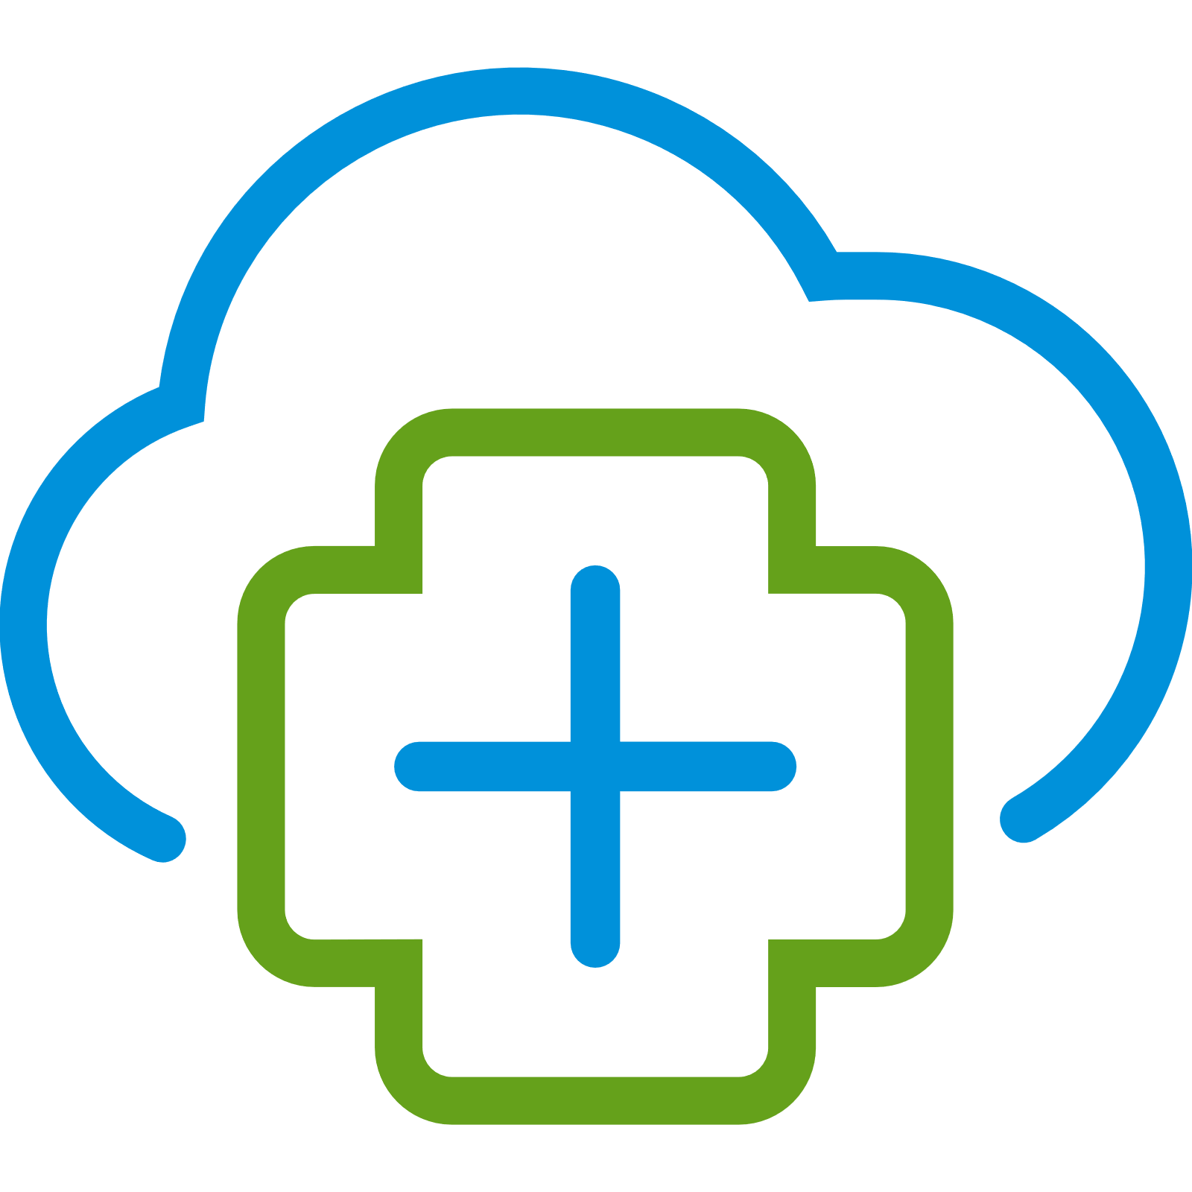

Why Aria Operations Cloud?
Benefits of cloud service for cloud alignment
Powered by AI
Accelerate service & innovation delivery
Increase Flexibility
Reduced risk Pay what you use
Reduce time to market
Feature parity
Easy on-boarding
Improve agility
No hardware & no maintenance
Dynamic
& reliable
Scale rapidly
Notes:
Align your operations model to your cloud model
Reduce time to market to accelerate innovation and product/service delivery by deploying capabilities faster, gaining widespread adoption, and automatic updates providing the latest features to users.
Improve operational agility to focus on other strategic priorities that support the goals of the organization by shifting the burden of maintenance, upgrades, and availability responsibilities from IT staff to the cloud provider (VMware)
Increase flexibility to quickly adapt the business to changing market conditions by easily experimenting or trying a new project with minimal risk, less complexity, and reduced commitment (knowing I have the freedom to change my mind in the future without penalty), along with the flexibility to move from a CapEx to an OpEx model and pay only for what is used.
Scale rapidly at the same pace as your company growth to keep up with customer demands by scaling your IT environment on-demand, dynamically, and reliably.

Slide 8
Aria Operations / Aria Operations Cloud
Key Benefits
Accelerate service & innovation delivery
Reduce time to market and automate infrastructure delivery
Improve agility
No hardware and no maintenance
Increase Flexibility
Reduced risk and CAPEX to OPEX
Scale rapidly
Dynamic and reliable with VMware SRE support
Future Ready
Manage traditional and cloud-native workloads across private, hybrid and multi-cloud environments

Slide 9
Use Cases Unlocked by vRealize Operations
Hyperconverged Infrastructure Operations
Consistent VMware Cloud Operations
App-aware Operations
Integrated Compliance
Unified Public Cloud Monitoring
Notes:
Hyperconverged Infrastructure Operations – Self-driving operations management, optimization, and planning for hyperconverged infrastructure including vSAN performance optimization, capacity/cost management, and troubleshooting, and HCI capacity/cost planning.
Consistent VMware Cloud Operations – Holistic self-driving operations management, optimization, and planning for VMware-based clouds including VMware Cloud Foundation, VMware Cloud on AWS, and vSphere-based VCPP clouds.
App-aware Operations – Infrastructure optimization with application-level visibility and awareness facilitating better decision-making and communication between infrastructure providers and consumers.
Container Operations – The self-driving operations framework applied to container-based workloads
Unified Public Cloud Monitoring – Visibility, monitoring, and planning for workloads residing on multiple public clouds including AWS, Azure, GCP, and others.

Slide 10
Initial Recommendations / Quick win
Recommendations. Focus efforts on critical & recent.
Declutter the environment with Reclamation
VM RightSizing –Group Bronze Class VM’s. Schedule rightsizing
Common used dashboards – Good OOTB or custom dashboards
Capacity Planning – Time Remaining. Set up policies on 1 particular cluster for capacity planning.
Troubleshooting Proactive – Workbench
Dashboard Folder – List your favs
Custom Groups for application types etc.
Adjust cost drivers to improve accuracy. Import env cost reports - Reports
Showback and Sustainability (Waste Management) Reports to Senior Management + ESG Team
Config/Compliance Management Reports: NTP, DNS, Power Management
Integrate Storage Arrays from 3rd Parties – Management Packs
Capture legacy O/S's using configuration dashboards and reports
Outbound alert settings
Change the default email payload to something more user friendly. See - Custom Aria Ops Content
Change the Home landing page to a more useable dashboard e.g vSphere Inventory
Skyline Data MP – Feed Security Vulnerabilities to Aria Ops. Send as report to SecOps
Enable a compliance pack. vSphere Security Guide vs the 100's line excel document = good start!

Slide 11
VMware Cloud Management
Multi-Cloud Franchise
Cloud Platform
Cloud Services
Cloud Management
Cloud Management
ARIA/vRealize
Cloud Health
Skyline
Aria Cloud Management
Products (on-prem & SaaS)
Pricing & Packaging
Aria Automation & Aria Automation Cloud
Aria Operations & Aria Operations Cloud
vRealize Log Insight & vRealize Log Insight Cloud
vRealize Network Insight & vRealize Network Insight Cloud
vRealize True Visibility
A La Carte
vRealize Suite
+
vCloud Suite
w/vRealize Lifecycle Manager
vRealize Cloud
+
vCloud Suite Subscription
+ VCF Subscription
vRealize AI
Notes:
HOW IS VMWARE CLOUD MANAGEMET STITCHED TOGETHER TODAY?

Slide 12



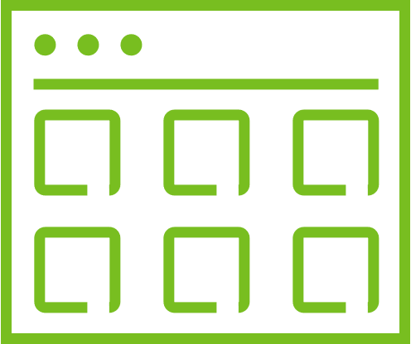




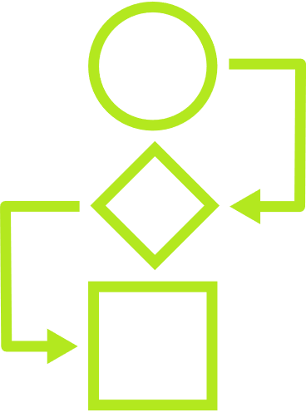


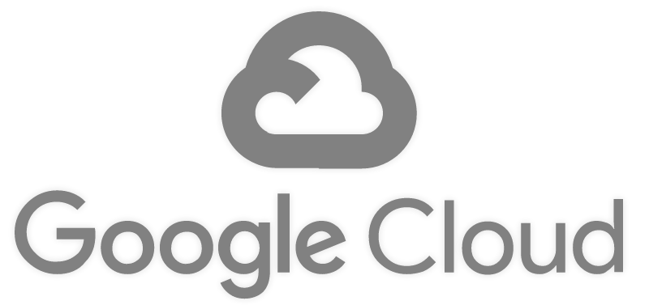
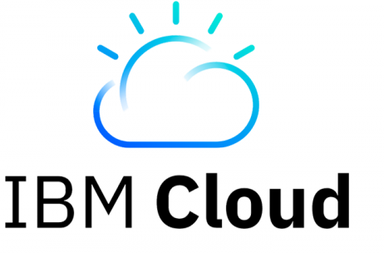
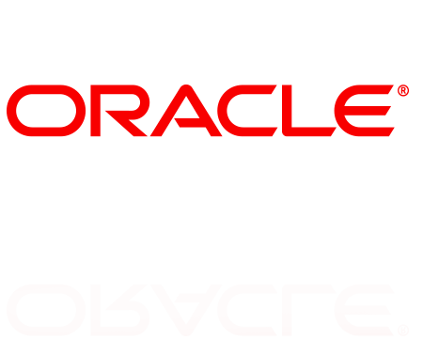
APP STRATEGY
Retain
Rehost
Replatform
Refactor
Retire
CLOUD OPERATING MODEL
3. MANAGE ACROSS CLOUDS
VMware Multi-Cloud Management
Cost
Performance
Secure Config
Delivery
2. BUILD PLATFORM
Kubernetes Runtime and Management
1. BUILD CLOUDS
VMware Cloud
Public Cloud
Cost
Performance
Secure Config
Delivery
Cost
Performance
Secure Config
Delivery
IAAS CAAS PAAS
IAAS CAAS PAAS
VMware Multi-Cloud Management
PRIVATE
PARTNER
SOVEREIGN
TELCO
EDGE
Microsoft
Azure
VMware Infra
Notes:
Customers don’t want to move from the tools they know, because they know the value of the rich data that has been logged in the disparate tools
There are incredible amount of dataset’s
Lot of history

Slide 13
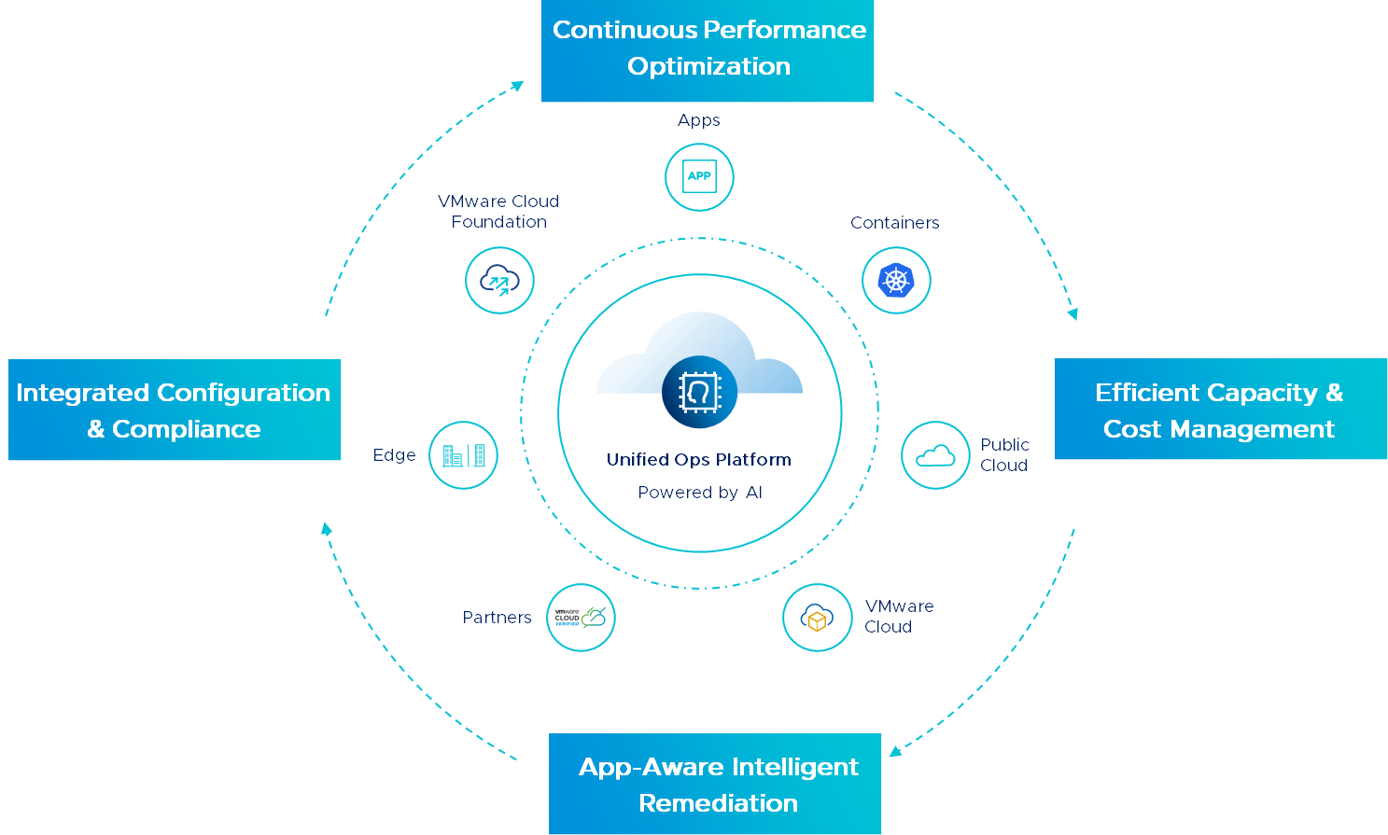
Self-Driving Operations with vRealize Operations
Powered by AI, from apps to infra, across VMware Cloud and multiple public clouds, on-premises or SaaS
Continuous Performance Optimization
Notes:
How do I maintain efficient operations
How do I enable governance and consistency
How do I minimize complexity?
..and enable governance and consistency
Continuous Performance Optimization - Continuously optimize app performance with automatic workload placement and balancing based on business and operational intent
Efficient Capacity Management – Run infrastructure like a public cloud — optimal consolidation, proactive planning, and procurement
Intelligent Remediation - Predict, prevent, and troubleshoot across hybrid and multi-cloud, from apps to infrastructure
Integrated Configuration and Compliance - Reduce risk and enforce IT and regulatory standards with integrated compliance and automated remediation
Flexible Deployment – Available as on-premises software or as a VMware cloud service

Slide 14
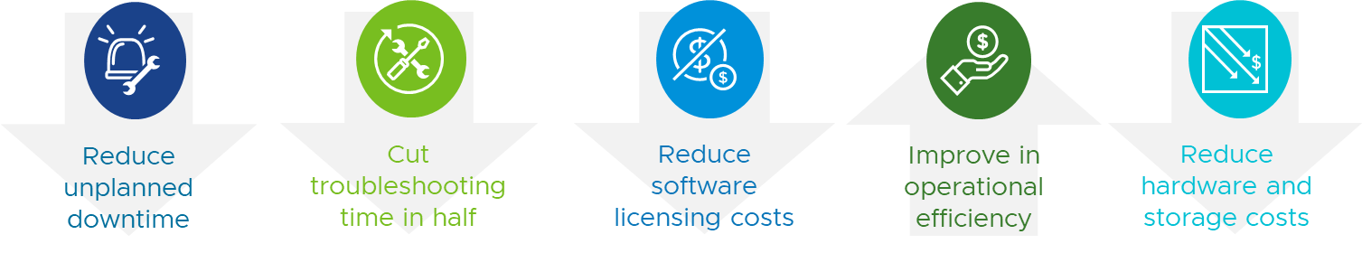

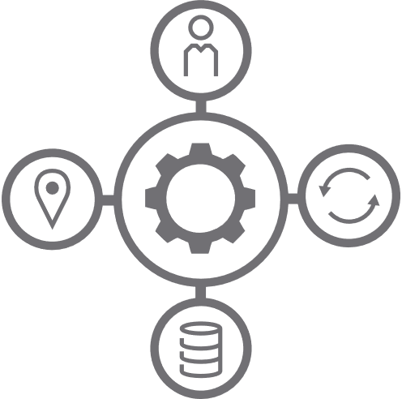



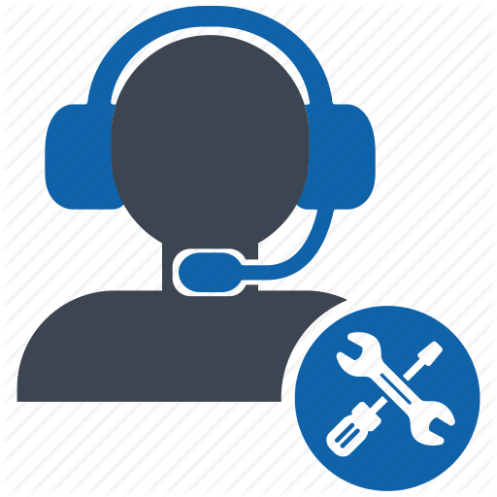

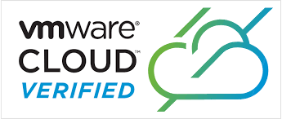
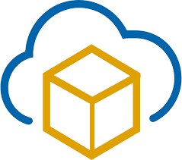

Self-driving operations: vRealize Operations Key Capabilities
Consistent operations for consistent infrastructure
Self-Driving Operations
OUTCOMES
Performance Optimization
INTENT & POLICIES
CAPABILITIES
Business Intent
Operational Intent
Capacity & Cost Optimization
Cost
Performance
SDDC Configuration Compliance
Compliance
Utilization
Service Level
Capacity
Intelligent Remediation
AI/ML Engine
PLATFORM
Continuous Optimization
Continuous Optimization
VMware
Skyline
Discover, Collect and Persist
Application Topology and Dependency mapping
Cloud assisted proactive support with actions
Metrics, Events, Configurations, Logs
VMs
Containers
SDDC (VCF)
EDGE
VCPP
VMC
PUBLIC CLOUD

Slide 15
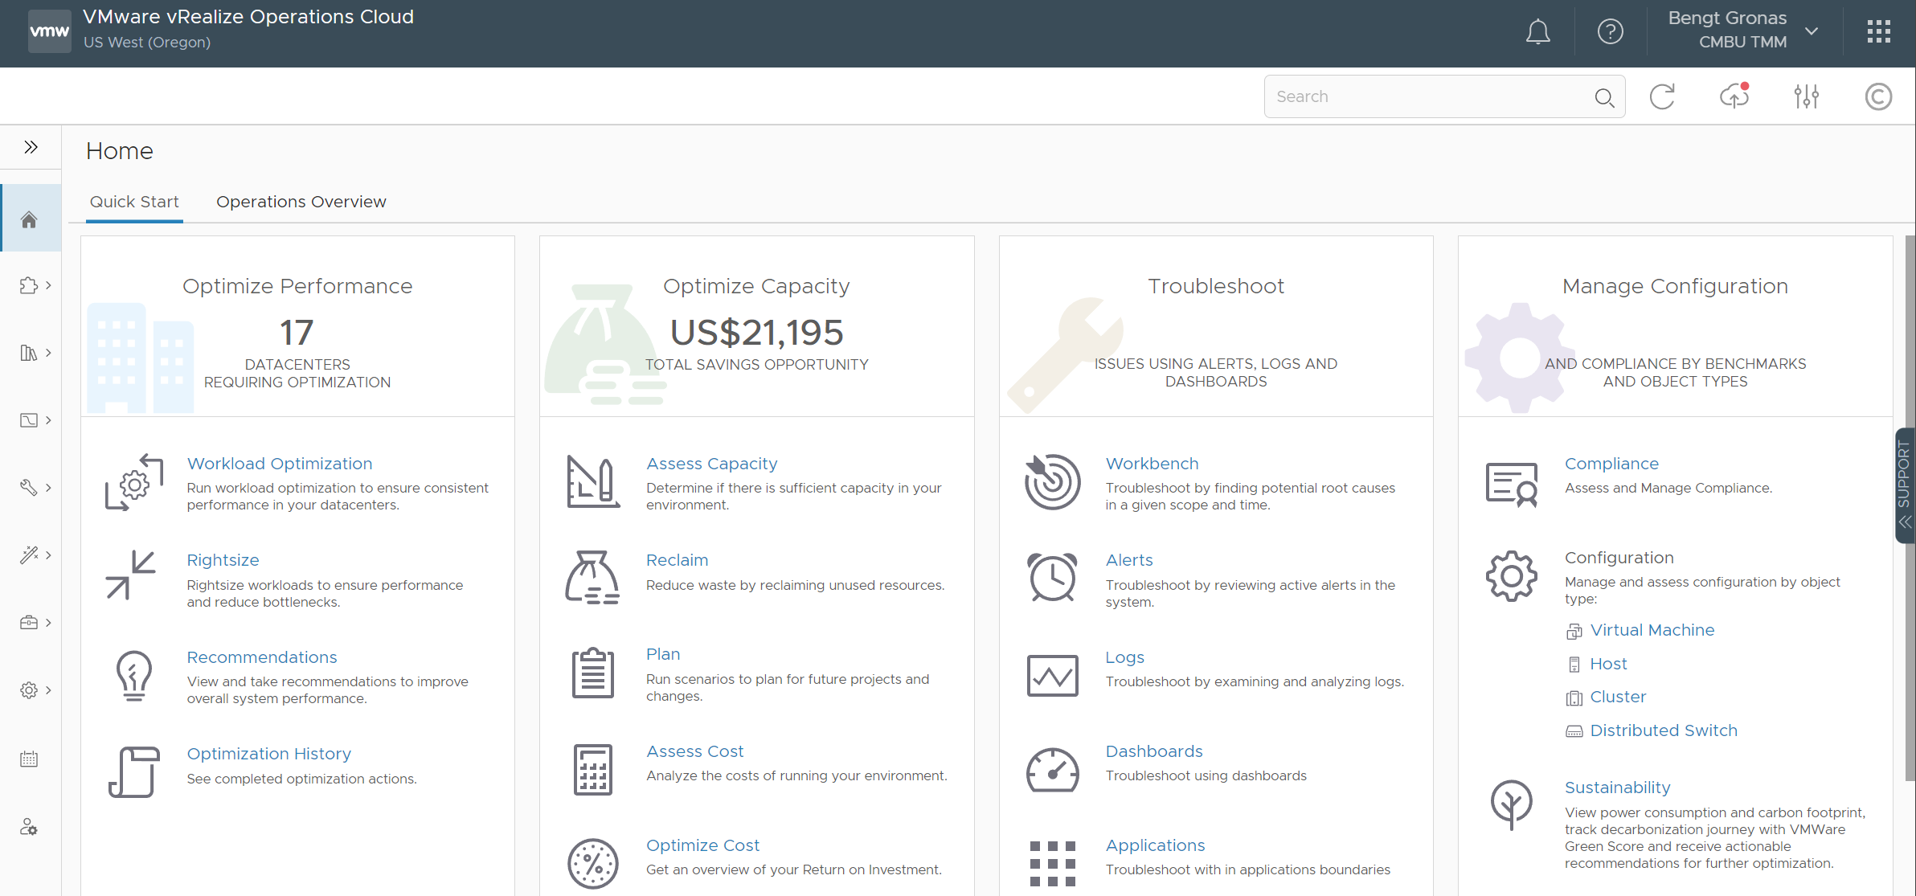
Feature Parity: vRealize Operations / vRealize Operations Cloud
Notes:
vRealize Operations Cloud
Has a common user interface as on-prem, and you can see the same quick start page.
Feature parity with on-prem
Same features as the 8.1 release for the enterprise edition.
PLUS = Support tab to reach out, get the product guide, Q&A, etc.

Slide 16
Continuous Performance Optimization
“
“
Can I achieve automated resolution of VM performance issues?
“
How can I make sure clusters don’t get filled beyond target?
“
How do I prevent VMs from getting deployed to clusters that are full?
“
“
“
Can I learn to predict & avoid contention?
“
“
“
Can I limit VM movement to manage licensing costs?
Can I consolidate and reuse for a new project?
“
“
Notes:
My environment is growing like crazy! Can I achieve automated resolution of VM performance issues without having to deal with them vm by vm? This is the marketingApp VM – it spikes every Mon-Wed – just learn its behavior and keep it happy
DevOps are deploying VMs at much faster rate, Clusters get filled up fast, How do I ensure that VMs don’t get deployed to clusters that are full or facing perf issues?
How do I ensure that clusters don’t get filled up beyond a target utilization level that will ensure there are enough resources for all?
If clusters and datastores do get full, How can my team build confidence to move VMs around that will guarantee that the VMs and the applications get the resources they want?
Budget cuts are happening, I must ensure Windows and Oracle license costs are contained. Can I limit their movement to a few set of clusters that I pay for?
I have an upcoming new project and need to free up production clusters, can I stack up to fit the VMs to minimal possible hardware to free up space to put new project VMs?

Slide 17
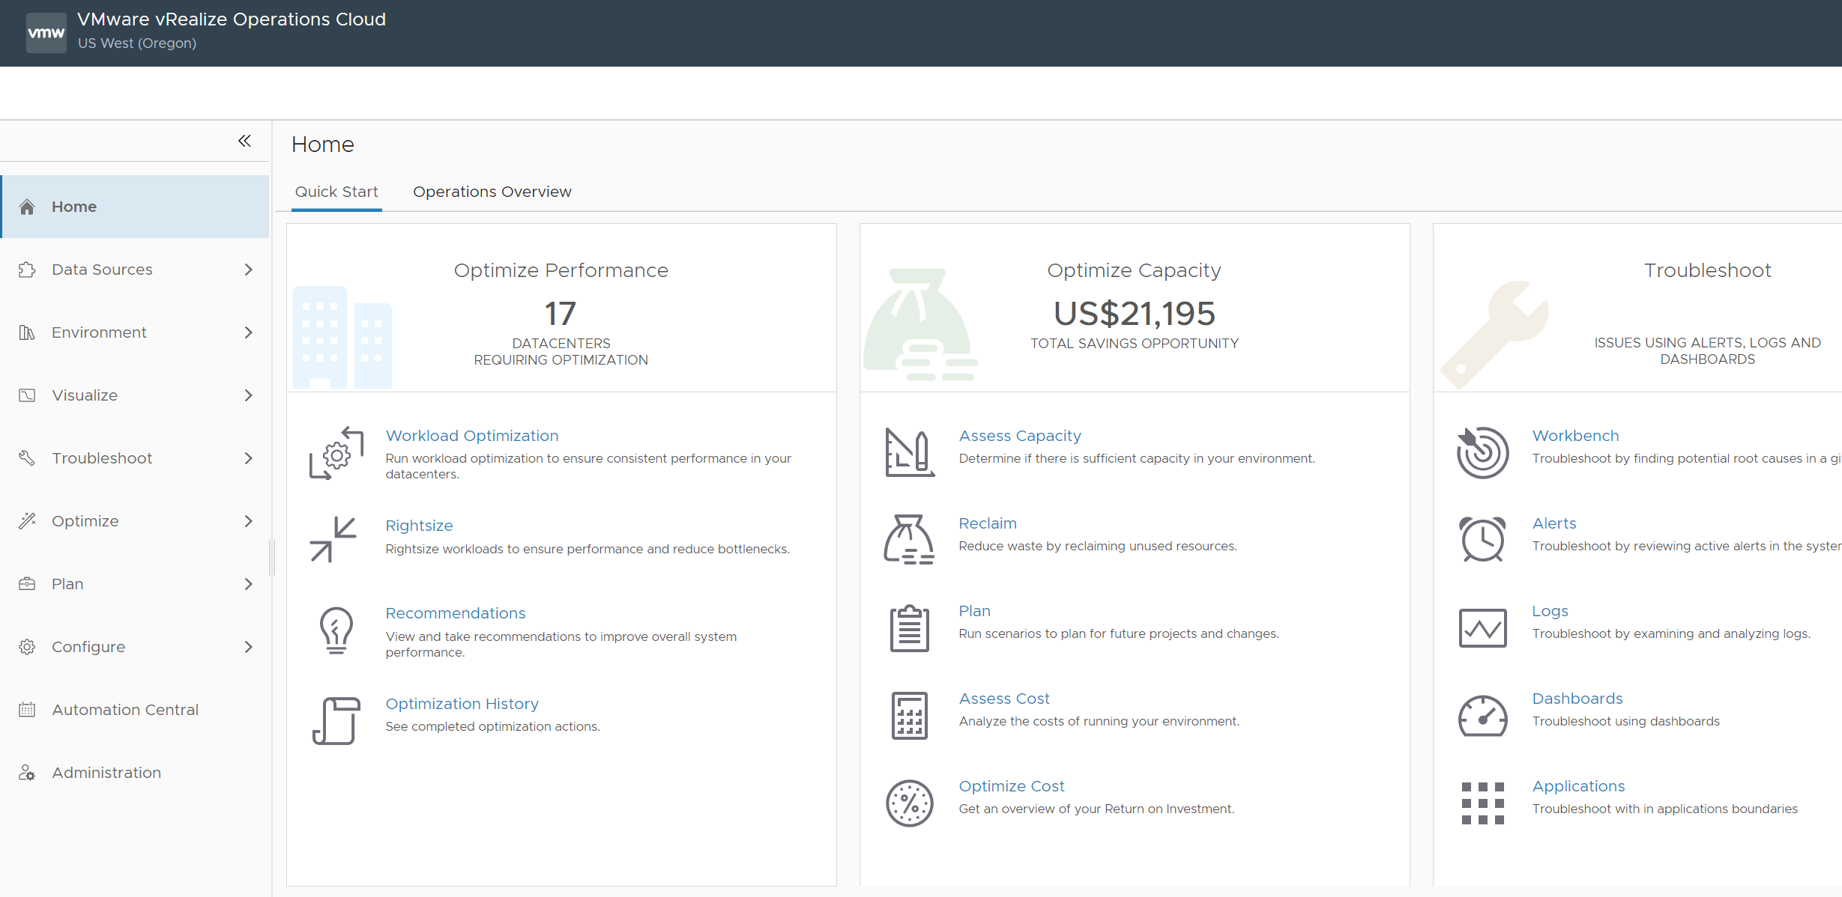
Intent-Driven Continuous Performance Optimization
Automated Intent-driven Workload Optimization and balancing for private cloud
Host-based placement for private cloud based on business and operational intent
Placement Optimization for vSAN workloads that is Resync, slack-space & SPBM aware
Intent-driven Workload Optimization and balancing for VMware Cloud on AWS
Integration with vRealize Automation for initial placement and on-going balancing
Next-gen CMP with shared constructs like cloud accounts, cloud zones and projects across Operations and Automation
Workload right-sizing for hybrid cloud
Predictive DRS to avoid contention
Notes:
RECOMMENDATIONS
RIGHTSIZING
WLP

Slide 18
Optimize & Plan Capacity across Private, Hybrid and Public Clouds
“
“
“
What is my total capacity and how much is used/remaining
When will I run out and how much more is needed? Cost?
How much capacity can I reclaim? Cost?
“
“
“
“
“
What is the cost of running VMs on private vs hybrid or public cloud?
What are the costs and usage in private/ public clouds?
“
“
Notes:
And there are more questions. You actually know all these questions. In fact, you’ve probably been asked before, and have been wondering about the answers.
How bad is the over-provisioning?
Which VMs can be right-sized, without impacting performance?
Does any VM abuse the shared IaaS platform?
Anyone can be running IOmeter without you knowing it. Later we’ll show you one real life example.
How healthy is your vSphere environment?
What vSphere alarms are we getting?
When do they happen? How often do they happen? Are you getting alarms at unexpected places?
Your IaaS platform is healthly and performing.
Sure. What does the logs say? Any early warning buried deep in the million lines of logs?
Most VMware admin/architect do not read the logs. Do you understand what the logs say?
Knowing what your logs say give you comfort level that your SDDC is operating well. Definitely a good thing to do before going for that 2 week vacation ;-)
Who makes what changes to what objects in vSphere and when?
This is a common auditor question. It includes additional questions such as who issue what CLI command to which ESXi
In the next session, we will begin answering all these questions, and more. By the end of the day, you should have the solution and dashboards to answer them all.

Slide 19
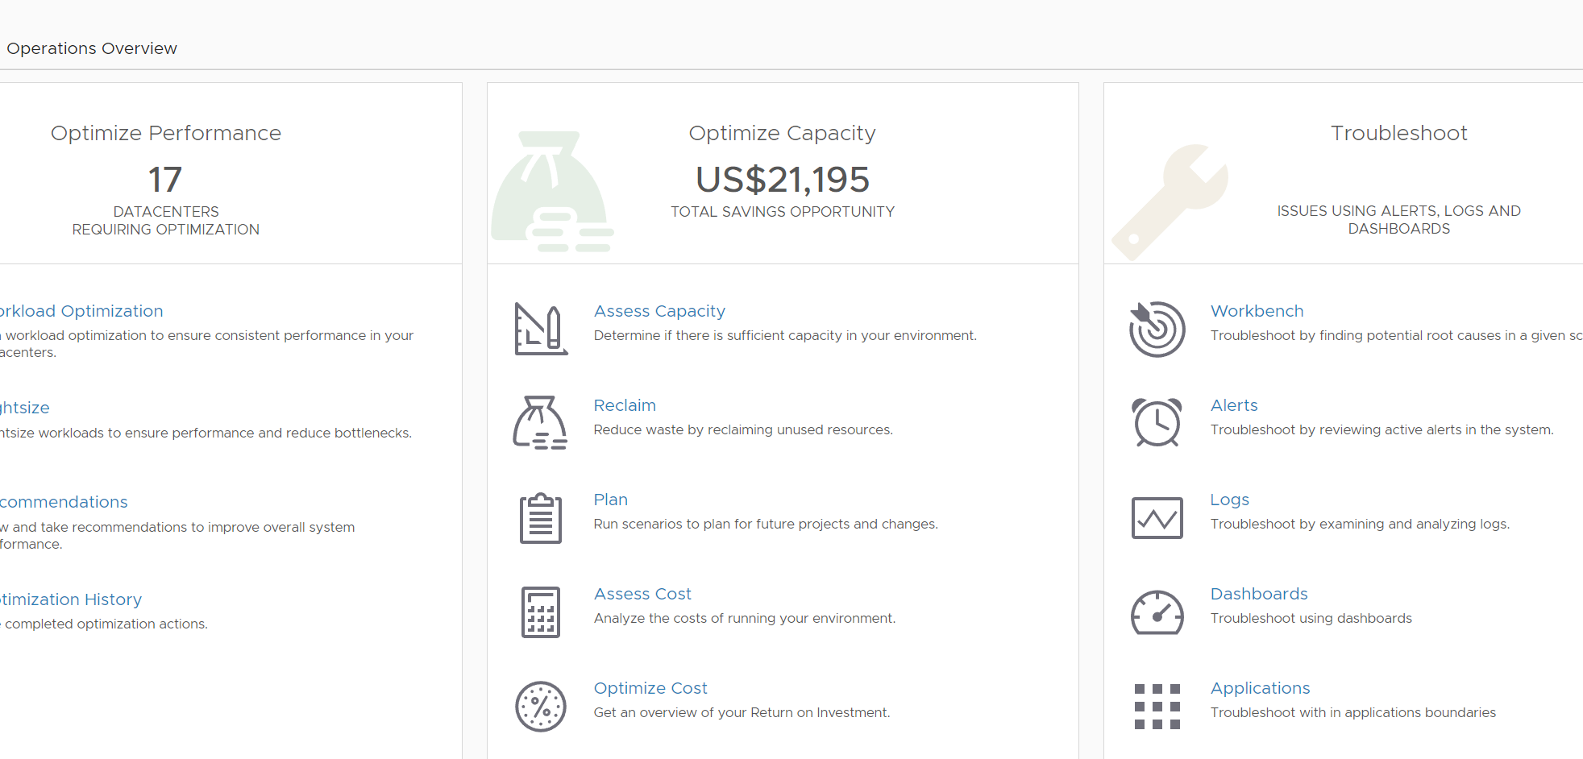
Efficient Capacity and Cost Management
Demand and Allocation Aware Capacity Management and Planning
Reclaim overprovisioned capacity, incl. from Orphan VMDKs
What-If scenarios for: workload and h/w removal; HCI planning
Stacked what-if scenarios
Migration planning to public cloud and VCPP partners
VMware Cloud on AWS migration assessment
Cost drivers: vSAN costs, individual server costs, total monthly OpEX costs
Enhanced Private Cloud Costing with per datacenter cost drivers
Rate-card based pricing
Private cloud cost comparison across data centers for new workload planning
Monitor costs for VMware Cloud on AWS infrastructure
Public cloud costing via CloudHealth integration
Notes:
Custom VM profiles to visualize capacity based on unique sizing requirements

Slide 20
Intelligent Remediation
“
“
“
How fast can I troubleshoot VMs, Hosts & Clusters in production?
“
How is my global environment doing?
“
How can I find problems vs dealing with alerts?
How can I become an expert at SDDC management?
“
“
“
“
“
Is the production environment configured correctly?
How can I monitor Containers/K8s and Public Clouds?
“
“
Notes:
What does it take to run production operations
Be able to proactively monitor how your environment is doing. Are there critical issues that need your attention around: Performance, Out of Capacity, Misconfigurations, Failures
Be able to quickly pinpoint or prove innocence for why a ‘production Vm is slow’
Be able to Proactively ensure VMs don’t face contention when underlying clusters run out of capacity by setting policies to automatically balance them around
Be able to assess total, used, remaining & reclaimable capacity and plan for upcoming projects
How do you do the above like an expert and for your production environment ?
How is my entire globally distributed environment doing? Is it serving the Vms and the Applications as needed?
Are there critical Applications who’s performance is being impacted due to infrastructure issues?
Are there hotspots creating bottlenecks? Are there outliers creating pressure?
Is the production environment configured to best practices to deliver the right performance and efficiency?
How can I make my team become experts at monitoring/troubleshooting vSAN as I adopt it into production?
How can I/my team collaborate with other teams and during war room situations to quickly Troubleshoot to pinpoint issues or eliminate layers of infra.

Slide 21
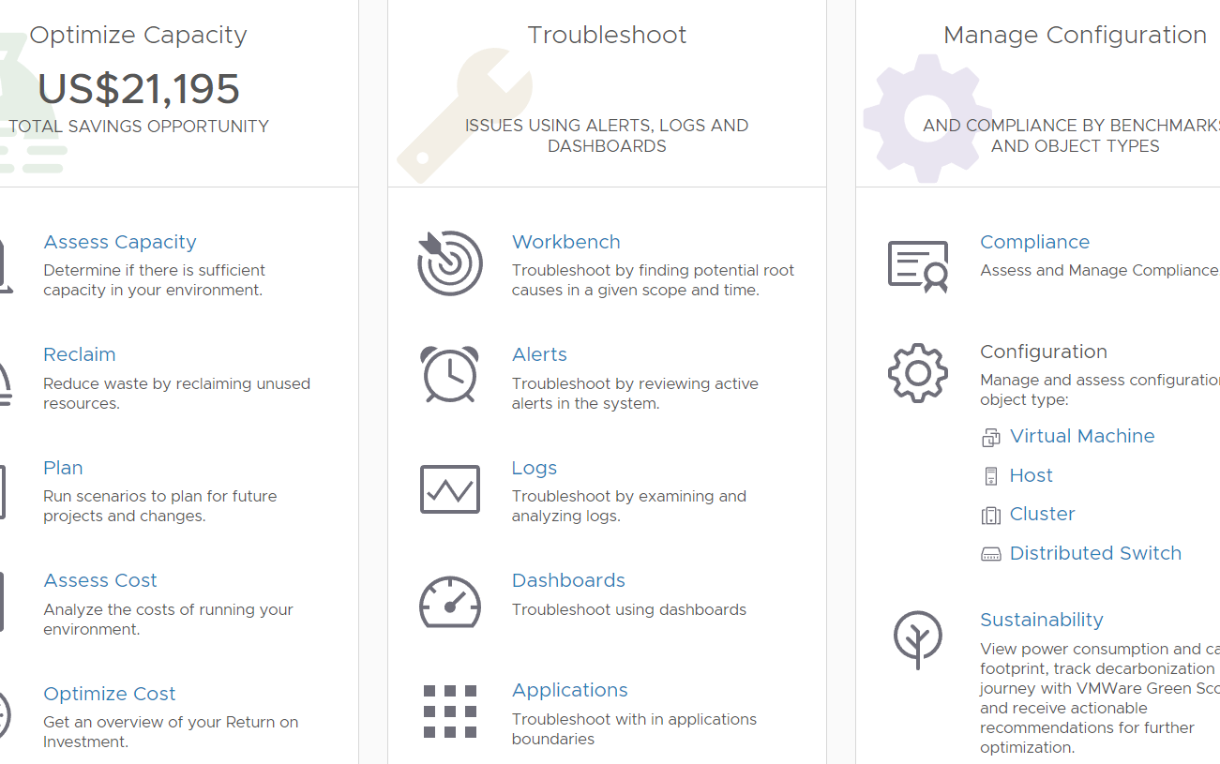
Intelligent Remediation
AWS, Azure, and GCP monitoring, including capacity management for AWS
vRealize Network Insight integration (including app discovery)
vRealize Log Insight integration
Service Now integration
Slack integration
Enhancement to management packs – SDDC, Cloud Pod, Container/PKS , vRO, NSX-T, VxRail, SNMP etc
Enhanced insights via Skyline
Troubleshooting Workbench for expediated root cause analysis
Kubernetes monitoring including vSphere 7 with Tanzu discovery, monitoring, troubleshooting, capacity management; support for Openshift, EKS, AKS, GKE, and downstream “Kubernetes anywhere”
Line of sight from apps to Infra, including (cloud-exclusive) APM tool integration and near real-time monitoring
Simplified alert creation, dashboard mgmt, consistent navigation & summary pages
Metric Correlation (including logs-as-metrics and log/metric correlation) and Super Metrics workflows for faster troubleshooting
OOB application monitoring (20 total) via Telegraf agents and custom script execution
Native Service Discovery with support for top-n processes and one-time script execution
Notes:
Custom Properties for enhanced process automation, reports, views
Flowgate management pack for facility systems and IT data

Slide 22
Integrated Compliance, Configuration, and Sustainability
“
“
“
What is my compliance stature against my org policies?
Am I meeting regulatory compliance needs?
How can I remediate drift?
“
“
“
“
“
Will I pass my compliance audit (PCI, HIPPA, DISA, CIS, ISO, FISMA)?
where are we in our sustainability journey?
“
“
Notes:
What does it take to run production operations
Be able to proactively monitor how your environment is doing. Are there critical issues that need your attention around: Performance, Out of Capacity, Misconfigurations, Failures
Be able to quickly pinpoint or prove innocence for why a ‘production Vm is slow’
Be able to Proactively ensure VMs don’t face contention when underlying clusters run out of capacity by setting policies to automatically balance them around
Be able to assess total, used, remaining & reclaimable capacity and plan for upcoming projects
How do you do the above like an expert and for your production environment ?
How is my entire globally distributed environment doing? Is it serving the Vms and the Applications as needed?
Are there critical Applications who’s performance is being impacted due to infrastructure issues?
Are there hotspots creating bottlenecks? Are there outliers creating pressure?
Is the production environment configured to best practices to deliver the right performance and efficiency?
How can I make my team become experts at monitoring/troubleshooting vSAN as I adopt it into production?
How can I/my team collaborate with other teams and during war room situations to quickly Troubleshoot to pinpoint issues or eliminate layers of infra.
SUSTAINABILITY
GREENSCORE
POWER CONSUMPTION
CARBON FOOTPRINT
ENVIRONMENTAL IMPACT

Slide 23
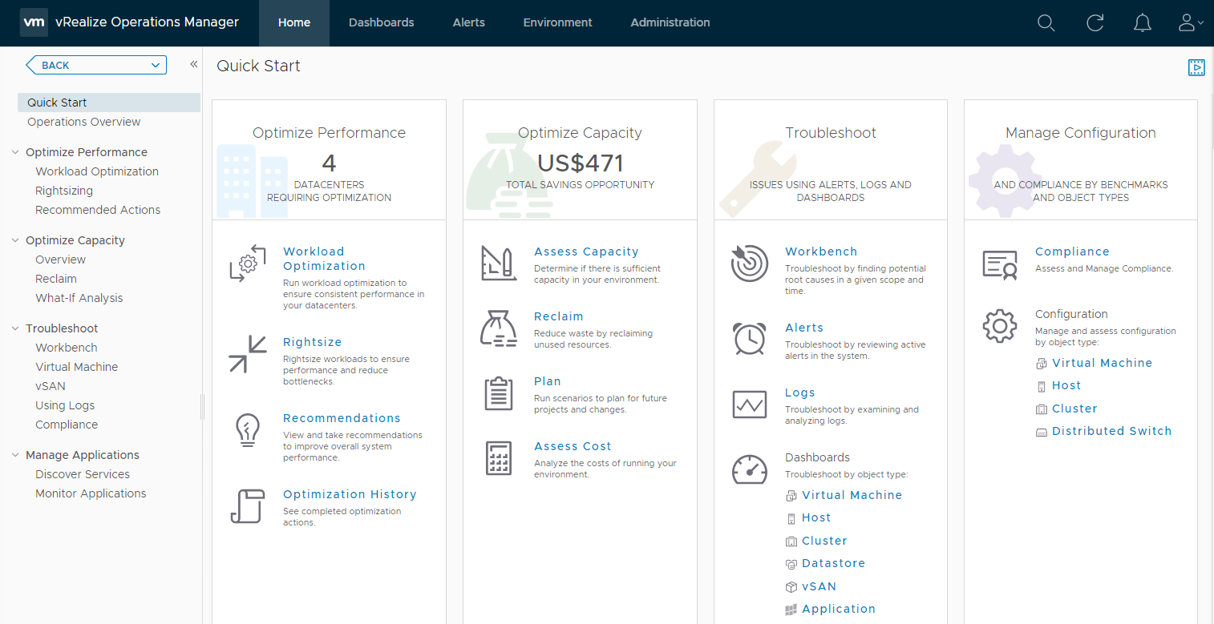
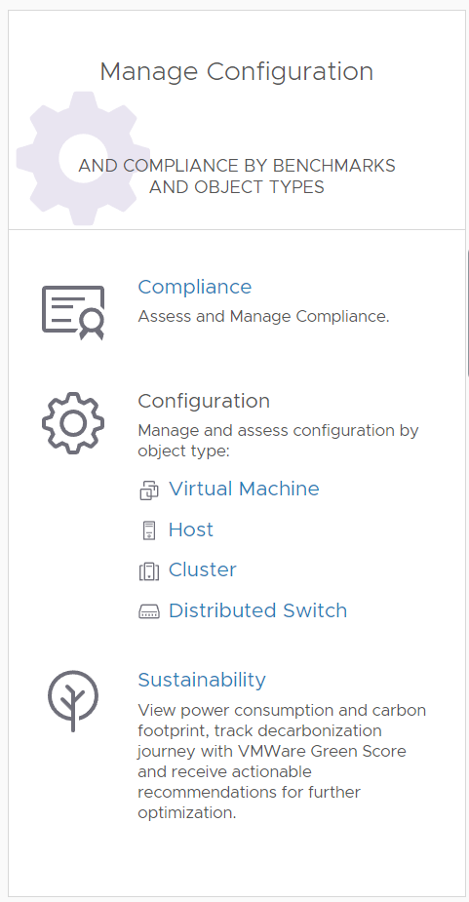
Integrated Compliance & Configuration
Simplified Compliance Workflows
Regulatory and SDDC compliance content (vSphere, NSX-T, vSAN)
Monitor compliance for VMs in VMware Cloud on AWS
Ability to create Custom Compliance standards
Automated configuration management with OOTB workflows and vRO integration
View power consumption and carbon footprint, track decarbonization journey with VMWare Green Score and receive actionable recommendations for further optimization
Notes:
Import/Export of custom compliance standards
Display score cards that help you proactively detect compliance problems
The compliance benchmarks are measured against a set of standard rules, regulatory best practices, or custom alert definitions.
Compliance benchmarks
Displays score cards based on alerts which are measured against the latest hardening guides:vSphere Security Configuration Guide
vSAN Security Configuration Guide
NSX Security Configuration Guide
Regulatory Benchmarks
Benchmarks for industry standard regulatory compliance requirements.
Health Insurance Portability and Accountability Act (HIPAA)
Payment Card Industry Data Security Standard (PCI DSS) compliance standards
CIS Security Standards
Defense Information Systems Agency (DISA) Security Standards
The Federal Information Security Management Act (FISMA) Security Standards
International Organization for Standardization (ISO) Security Standards
VMware Green Score is what organizations can use to track where they are in their decarbonization or sustainability journey and how they progress over time. The latter is more important than the former as it’s about “improving yourself”
Greenscore Details
Greenscore is calculated based on five components:
Workload Efficiency: Contributes to 22.5% weightage Efficiency = Wastage / (Wastage + Non Wastage).
Resource Utilization: Contributes to 12.5% weightage based on the utilization of hardware from the absolute capacity without considering buffers and HA.
Virtualization: Contributes to 15% weightage.
Power Source: Contributes to 37.5% weightage. Scoring is based on the carbon intensity of the power source used.
Hardware Efficiency: Contributes to 12.5% weightage, based on the fact that newer generation hardware will be more energy efficient.
Each of these components has varying levels of impact on the carbon emissions within a datacenter and hence has a different weightage when contributing to a common Greenscore.

Slide 24
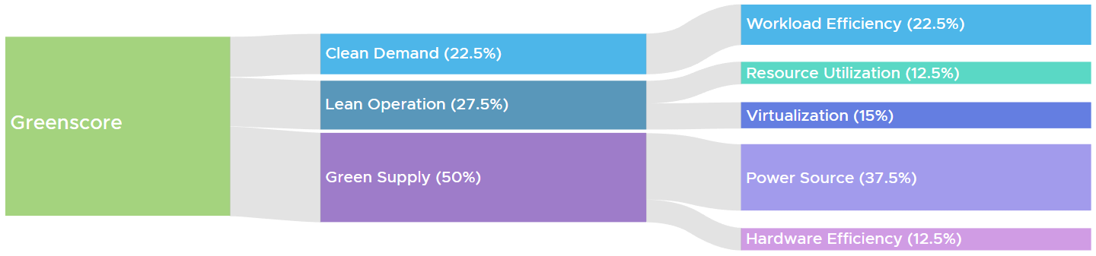
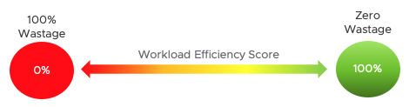
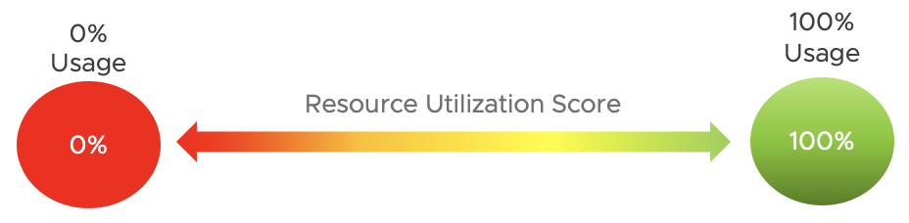
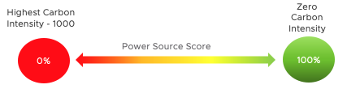
SUSTAINABILITY
Vmware Green Score
Simplified Compliance Workflows
Regulatory and SDDC compliance content (vSphere, NSX-T, vSAN)
Monitor compliance for VMs in VMware Cloud on AWS
Ability to create Custom Compliance standards
Automated configuration management with OOTB workflows and vRO integration
View power consumption and carbon footprint, track decarbonization journey with VMWare Green Score and receive actionable recommendations for further optimization
https://www.epa.gov/energy/greenhouse-gases-equivalencies-calculator-calculations-and-references#smartphones
https://blogs.vmware.com/management/2022/11/vmware-green-score-in-aria-operations-formerly-vrealize-operations.html
Notes:
Import/Export of custom compliance standards
Display score cards that help you proactively detect compliance problems
The compliance benchmarks are measured against a set of standard rules, regulatory best practices, or custom alert definitions.
Compliance benchmarks
Displays score cards based on alerts which are measured against the latest hardening guides:vSphere Security Configuration Guide
vSAN Security Configuration Guide
NSX Security Configuration Guide
Regulatory Benchmarks
Benchmarks for industry standard regulatory compliance requirements.
Health Insurance Portability and Accountability Act (HIPAA)
Payment Card Industry Data Security Standard (PCI DSS) compliance standards
CIS Security Standards
Defense Information Systems Agency (DISA) Security Standards
The Federal Information Security Management Act (FISMA) Security Standards
International Organization for Standardization (ISO) Security Standards
VMware Green Score is what organizations can use to track where they are in their decarbonization or sustainability journey and how they progress over time. The latter is more important than the former as it’s about “improving yourself”
Greenscore Details
Greenscore is calculated based on five components:
Workload Efficiency: Contributes to 22.5% weightage Efficiency = Wastage / (Wastage + Non Wastage).
Resource Utilization: Contributes to 12.5% weightage based on the utilization of hardware from the absolute capacity without considering buffers and HA.
Virtualization: Contributes to 15% weightage.
Power Source: Contributes to 37.5% weightage. Scoring is based on the carbon intensity of the power source used.
Hardware Efficiency: Contributes to 12.5% weightage, based on the fact that newer generation hardware will be more energy efficient.
Each of these components has varying levels of impact on the carbon emissions within a datacenter and hence has a different weightage when contributing to a common Greenscore.

Slide 25



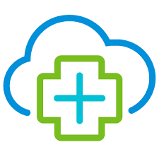



vRealize True Visibility Suite
Attain data depth & context in a single view, with relationship-aware monitoring integrations
Collaborative Management
Applications
Database
With the ability to aggregate operations data from the leading server, storage, compute and database applications, vRealize becomes single source of truth for multiple IT teams.
Connectors
Compute
vRealize Operations
End-to-end visibility
Relationship-Aware Monitoring
Provide value through a unified view, integrating data from your datacenter infrastructure and applications to create a cohesive monitoring strategy.
Quickly assess the state-of-affairs and gain a deeper understanding of how one piece of the stack might be affecting another.
Converged & Hyper-Converged
Network
Virtualization, Container & Cloud
Storage
Notes:
vROps residing in the center and covering all the “core” SDDC elements (vSphere, vSAN, TKG, etc). TVS integrates into vROps.

Slide 26
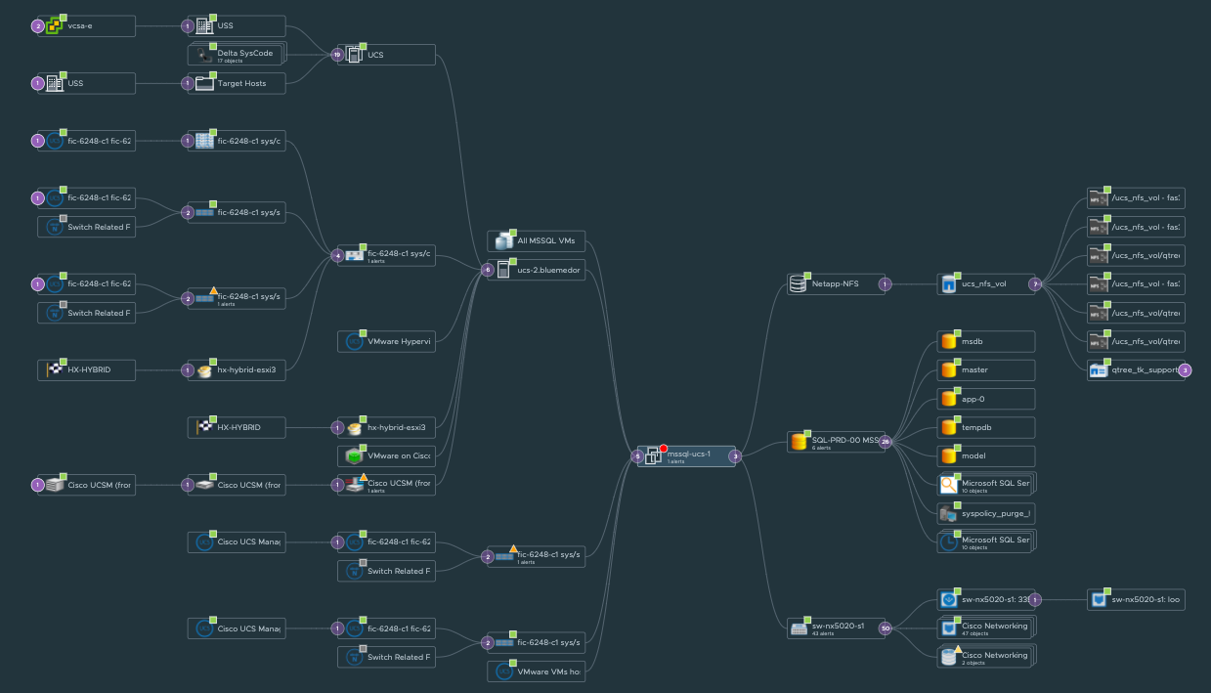


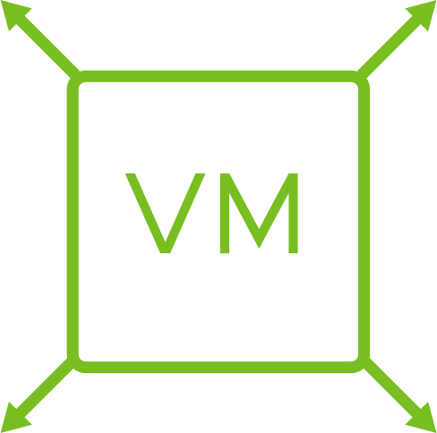

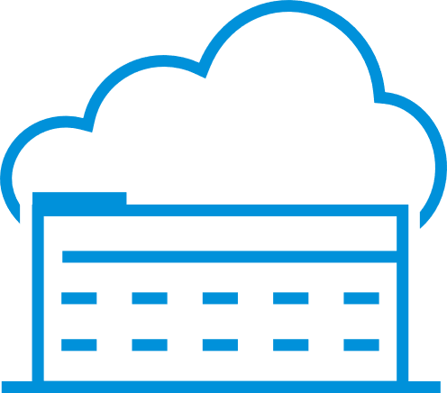
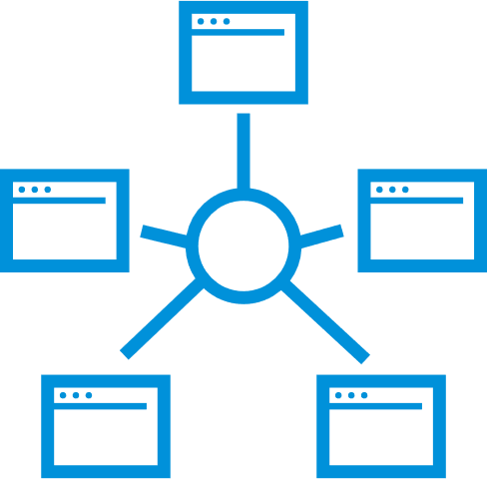
Extending vRealize Operations
Adding the vRealize True Visibility Suite
vRealize Operations
Application-aware monitoring across SDDC and multiple clouds
Compute Chassis
Cloud planning, capacity optimization and compliance
Compute Blade
Storage Volume
Datastore
Automated and proactive workloads management
Compute Network
ESXi Host
VM
vRealize True Visibility Suite
Database Instance
Deeper root cause analysis
Database
Database Queries
Wider collaboration for hybrid cloud management
Network Switch
Full stack resource dependency mapping
Network Ports
Notes:
MARKETPLACE
CUSTOMER CONNECT

Slide 27

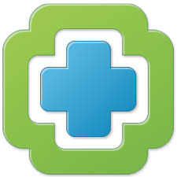
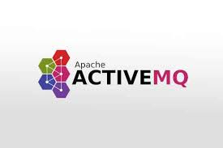
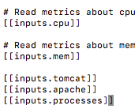

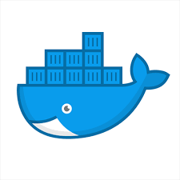
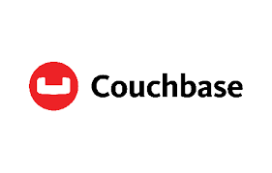
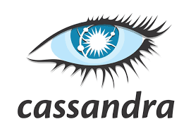
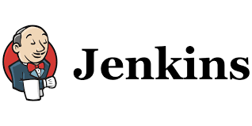
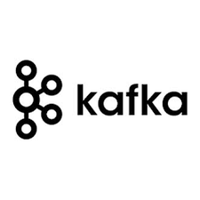
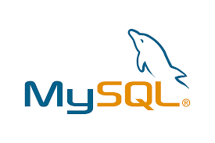
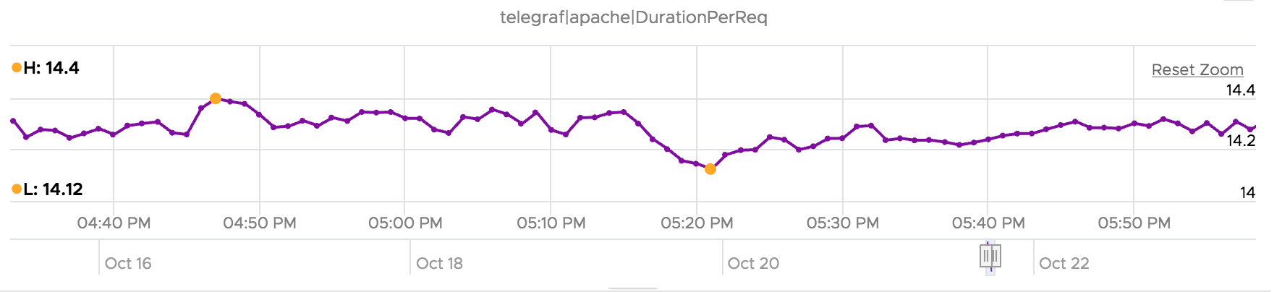

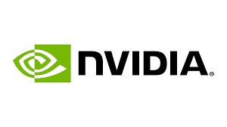
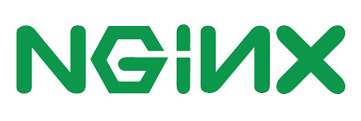
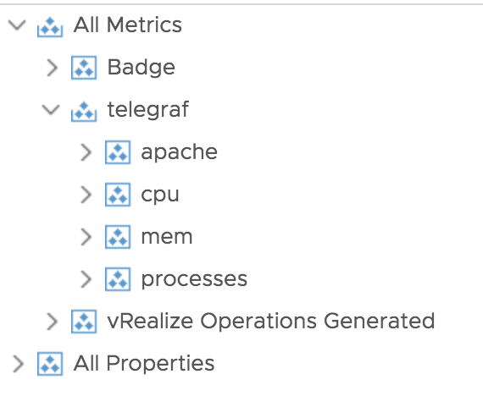



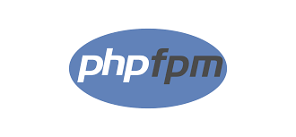
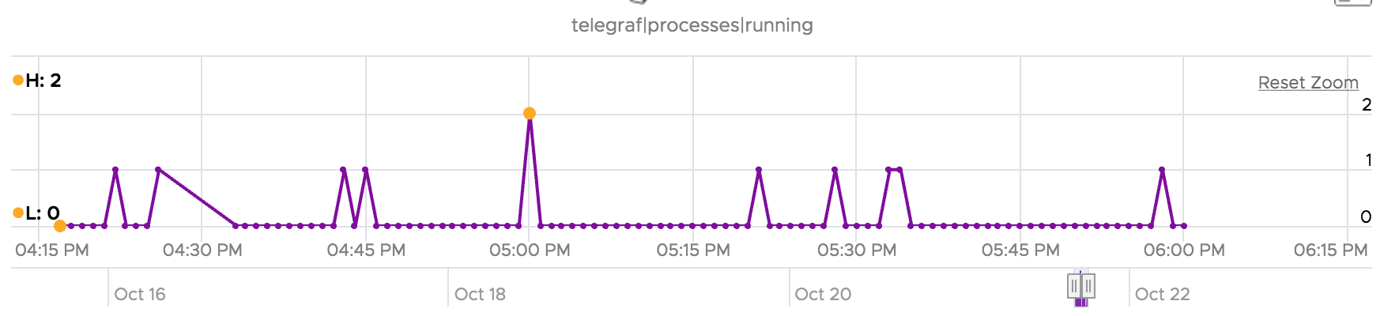

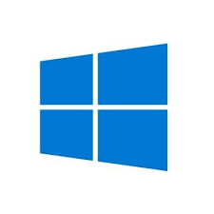
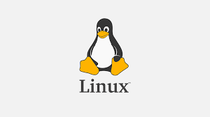
Open source telegraf support
Self-Service data collection supporting 200+ applications
sudo dnf -y install telegraf
Input Plugins
Cloud proxy
Notes:
ANY OS, NOT JUST VIRTUAL

Slide 28

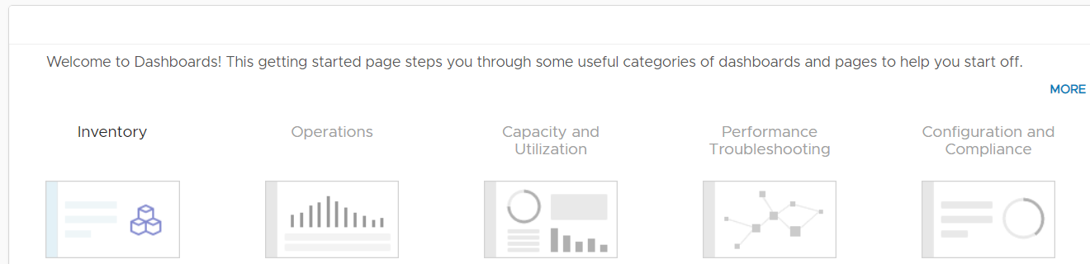
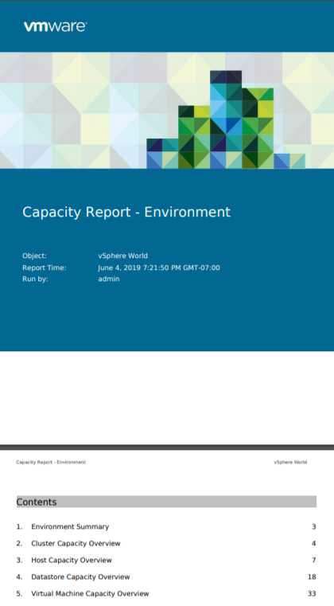

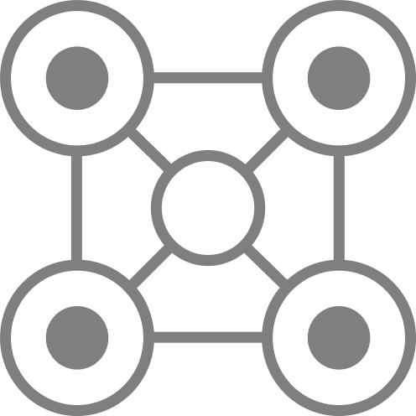
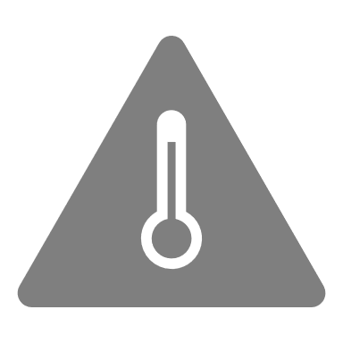

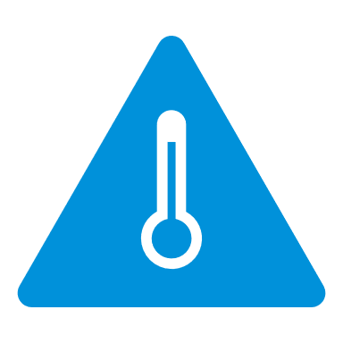

















Enhanced visibility with predictive alerts, dashboard and reports
Increase monitoring efficiency with key operational tools
ALERTS
DASHBOARDS
REPORTS
Alert Definitions
Dashboards
Report Templates
50+ Out of box report templates covering multiple use cases
Inventory
Configuration
Compliance
Capacity
Utilization
Performance
Impacted Objects
Impact Type
Correlated Symptoms
Recommendations & Actions
Helps visualize data through out of box and custom dashboards
Optimization
Other Solutions
Custom
Symptoms
Widgets & Views
PDF | CSV
Data Transformation
Events
Configs
Metrics
Rest
40+ Interactive Widgets & 100+ customized views with data transformation capabilities
Multiple views for excel like capabilities to transform data and present them within report templates
Recommendations
Dashboard Sharing
Report Sharing
KB Articles
Actions
Custom
Dashboard sharing with internal & external teams
Manual
Report Generation
Scheduled
Curated Python Actions
Curated/Custom vRO Workflows
Rest API
API
Actions
Community curated dashboard samples through GitHub
Email
Report Sharing
Network Share
API
Rest API
Notes:
Recommendations>Actions
Dashboard sharing and code.vmware.com
Reports > management!

Slide 29







Intelligent monitoring and root cause analysis
Leveraging anomaly detection and root cause analysis from applications to HCI
Dynamic time range to define problem scope
Finds potential root cause across with Events, Config Changes and Anomalous Metrics
Monitoring & Troubleshooting
Ecosystem integrations for a unified view from apps to infrastructure.
Predictive alerts with multi symptom correlation across metrics, events and logs.
Troubleshooting workbench with predictive root cause analysis using anomaly detection and correlation algorithms.
Complete visibility into Private and Public cloud resources in a single pane of glass
Dynamic full stack topology to define problem scope
AI/ML Engine Root Cause Recommendations

Slide 30










Connecting to Aria Operations
Skyline
Multi-Cloud
APMs
vRNI
Operations
vRA
vRLI
vR TVS
vRAI
CloudHealth
3rd Party
MP Designer
Synthetic Monitoring

Slide 31
With Log Insight
other monitoring solutions
Interface
REST API
vRealize Operations
on-prem
SaaS option
offer
vRealize Log Insight
on-prem
SaaS option
offer
Infrastructure Monitoring with Application Visibility
Consumer: Infrastructure Operations
integration
360° view
Management Packs, BlueMedora, custom
Content Packs
metrics
metrics
logs
logs
agent less
agent option
agent option
Syslog ingestion API
OS
OS
Database, Middleware, Applications
Infrastructure, Hardware, Hypervisors
on premise, cloud

Slide 32



Aria Operations and Aria Automation Integration
Public Cloud Deployments
Extend capabilities to public cloud resources (AWS, Azure, GCP)
OOTB Dashboards for Public Cloud Resources and Deployments
Partial Deployments
Costing, performance metrics, optimization recommendations in vRA
Project Level Limits
Visibility to vRA Project Limits
Alerts can be created for resource utilization or cost as limits approach
Notes:
Public Cloud
Support for deployments made to Big-3 public clouds: AWS, GCP, and Azure
Deployment object and details are brought into vROps to provide vRA context for Public Cloud applications
Use deployment context with OOTB dashboards in vROps
Partial Deployments
vRA may not be able to deploy ALL the workloads in a deployment (for a number of reasons) but that doesn’t mean we shouldn’t monitor those deployments with vROps
Full support for partial deployments
Project Level Limits
vRA limits used to control resources projects have access to in a cloud zone
Can create alerts for breaches (or as breaches are approached)

Slide 33






Deep Troubleshooting Paths
Aria Operations for Applications – Aria Operations
Launch in-context to Troubleshooting Workbench
AOA Dashboard
Drill down into deep analysis of infrastructure component
a test
Understand topology and dependencies
Launch Object Browser

Slide 34


The same application, two perspectives
Observability from all angles
Topology
Health
Capacity
Compliance
App discovery
Throughput
Latency
Error rate
Correlation
Aria Operations (AO)
Aria Operations for Apps (AOA)

Slide 35

Q&A
Notes:
Click to add notes

Slide 36


Account information
HOL-2201-01-CMP student check-in – LET’S GO!!!
Name: holadmin
(VMware identity manager)
Password: VMware1!
Notes:
Now, let’s get to it
When we log in to the lab, we will be a Hands-On Lab Admin called holadmin, and the admin password will be Vmware One Bang!
So first of all let’s find

